Slide 1
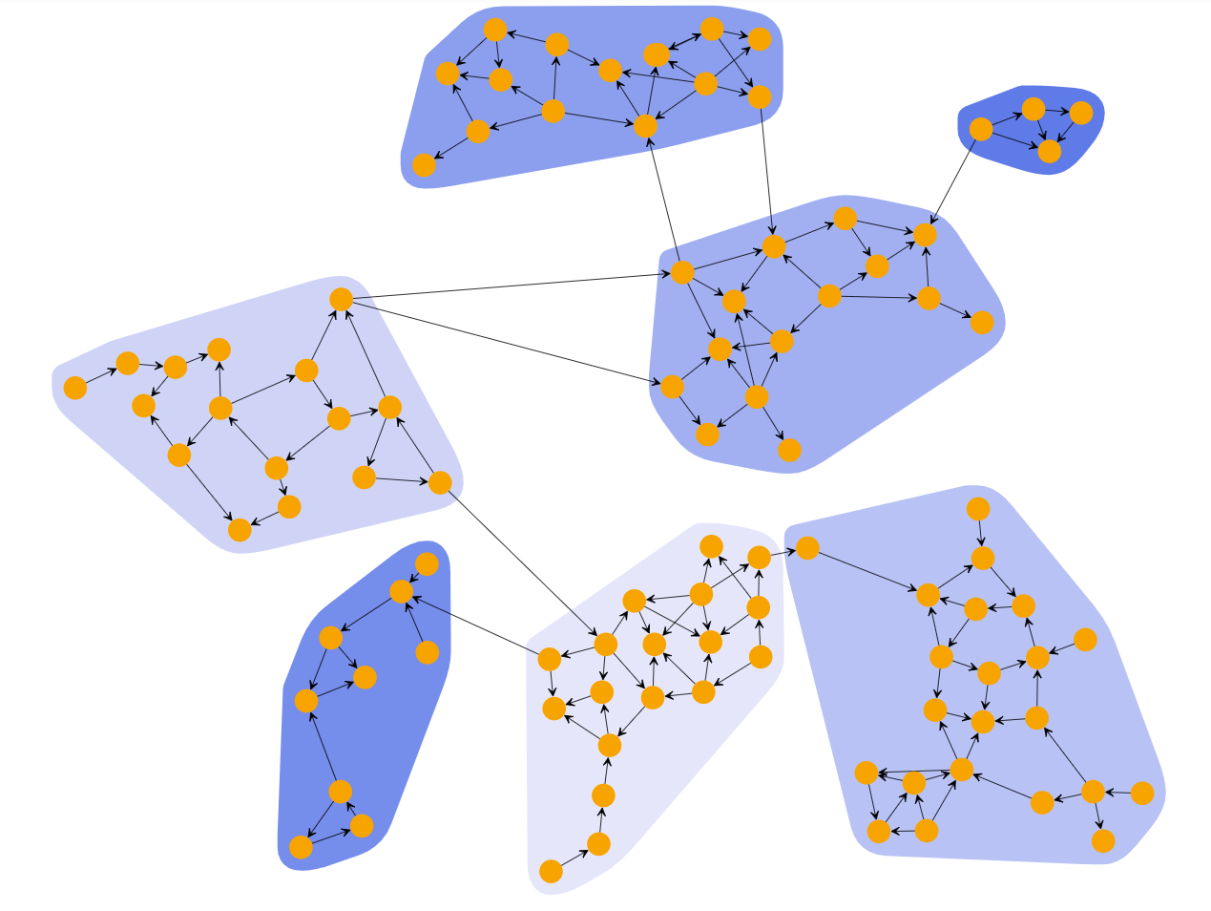
Clustering
Data 624 Presentation - Week 12
11.19.24
Presented by:
Will
John
Darwhin
Tenzin
Chafiaa
Puja

Slide 2
Introduction to Clustering
Definition of Clustering
Dividing data objects into groups that have more in common with each other than with those in other groups.
Includes a family of algorithms such as hierarchical, density-based, or k-means, which group data in different ways.
Importance in Data Analysis
Useful as a preliminary technique for exploring datasets without labels.
Example: A company analyzing survey data (e.g., age, gender, past purchases) could use clustering to segment customers and tailor marketing campaigns or product features.

Slide 3
Supervised vs. Unsupervised Learning
Supervised Learning
Training a model with labeled data.
Examples: Email filtering (ham vs. spam), Sentiment Analysis,
Unsupervised Learning
Analyzing unlabeled data to infer patterns.
Examples: Reducing high-dimensional data (e.g., thousands of variables) to 2D or 3D for easier visualization and interpretation.
Clustering is an example of an unsupervised technique.
Clustering in Unsupervised Learning
Clustering helps reveal hidden structures in data by grouping similar elements.
Guides decision-making with domain knowledge, though it doesn’t explicitly define actions for each group.

Slide 4
Classification vs. Clustering
Classification:
Supervised learning method.
Requires labeled data for training.
Predicts predefined categories or classes.
Examples: Email spam detection, disease diagnosis.
Clustering:
Unsupervised learning method.
Works with unlabeled data.
Groups data based on similarities or patterns.
Examples: Customer segmentation, image grouping.
When to Use Clustering Instead of Classification:
When labels are unavailable or impractical to define.
To explore and identify natural groupings or patterns in data.
For tasks like anomaly detection, market research, or exploratory data analysis.
Key Takeaway: Use clustering to discover hidden patterns, and classification to assign predefined labels based on learned criteria.
Notes:
#3 Puja
Now let’s look at the main differences between Classification and Clustering which are both popular in machine learning.
First, Classification is a supervised learning. This means it needs labeled data to train the model. The goal of classification is to predict which category or class a new data point belongs to based on the labeled training data. Examples of classification are spam email detection or disease diagnosis where the model has predefined labels to learn from.
On the other hand, Clustering is an unsupervised learning. It doesn’t need any labeled data. Instead, clustering algorithms try to group similar data points together based on patterns or similarities they share. You might use clustering when you don’t have predefined categories and you want to find natural groupings within the data. Common examples of clustering are customer segmentation or image grouping.
So, when should you use Clustering instead of Classification? Clustering is ideal when:
You don’t have labeled data or it’s too expensive to label the data.
You want to find patterns or structures in the data that weren’t known before.
It’s useful in market research or exploratory data analysis where you want to uncover hidden insights rather than assign fixed labels.
In short, use classification when you have labeled data and a clear goal of predicting categories. Use clustering when you’re looking to explore and discover patterns in data without labels.

Slide 5
Types of Clustering Algorithms
K-means
Gaussian Mixture Models
Hierarchical Clustering
Density Based Clustering (DBSCAN)

Slide 6
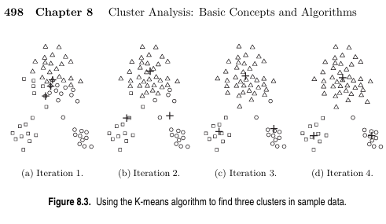
K-means
The k-means algorithm captures the insight that each point in a cluster should be near to the center of that cluster.
The K-Means algorithm operates through an iterative process to partition the dataset into k clusters.
Select the number of clusters (K): Decide the number of clusters you want to form.
Initialize centroids: Randomly select k points as initial centroids.
Assign data points to clusters: Assign each data point to the nearest centroid, forming k clusters.
Update centroids: Calculate the new centroids by taking the mean of all data points assigned to each cluster.
Repeat: Reassign data points to the nearest centroid and update centroids until the centroids no longer change or a maximum number of iterations is reached¹².

Slide 7
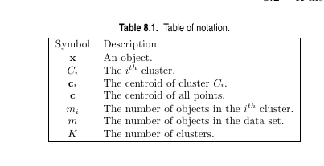


K-means:
Minimizing the Sum of Squared Errors
- (SSE) Key Concept: Objective: The main goal of K-Means is to minimize the Sum of Squared Errors (SSE) within clusters.
- A lower SSE indicates that points are closer to their respective centroids, resulting in more cohesive clusters.
- What is Sum of Squared Errors (SSE)?Definition: SSE measures the total squared distance between each data point and the centroid of its assigned cluster.

Slide 8
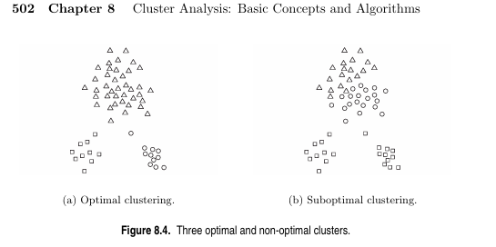
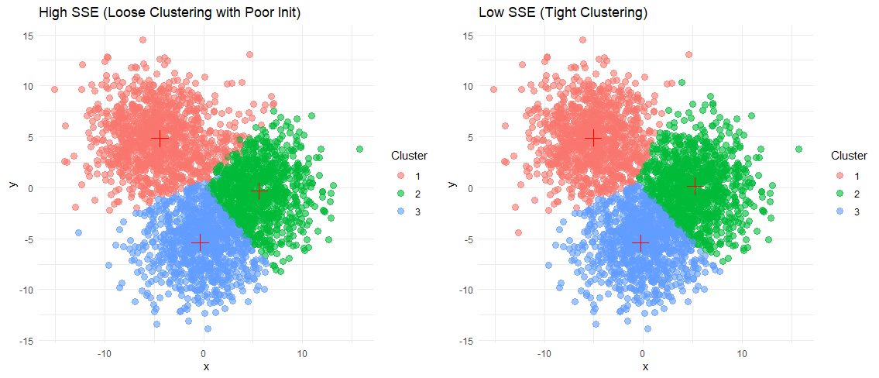
Sum of Squared Errors (SSE)
Why Minimize SSE?
Tighter Clusters:
Lower SSE means that points within a cluster are closer together, making the clusters more compact.
Better Representation: Centroids are more representative of their clusters, improving the interpretability and quality of the clustering.

Slide 9
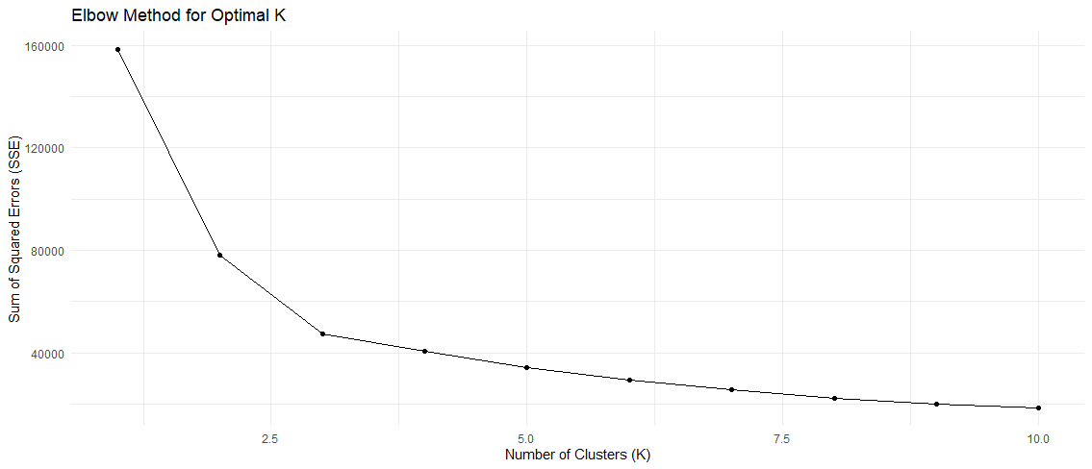
Choosing K
Elbow Method: A technique to find the optimal number of clusters (K) by balancing simplicity and fit quality.
How it works:
Run K-Means with different values of K, calculating Sum of Squared Errors (SSE) for each.
Plot SSE vs. K: Observe how SSE decreases as K increases.
Interpreting the Plot:
Elbow Point: The optimal K is where the SSE reduction slows down sharply, creating an "elbow" shape.
The elbow appears around K=3 where additional clusters bring minimal improvement.
Reasons to use the elbow method for selecting K
Simplicity: Chooses the smallest number of clusters that represents the data well.
Avoid Overfitting: Prevents adding unnecessary complexity with extra clusters.

Slide 10

Gaussian Mixture Models
Key Concepts of Gaussian Mixture Models (GMMs)
1. Mixture of Gaussians: Models data as a combination of Gaussian distributions.
2. Soft Clustering: Assigns probabilities of belonging to multiple clusters.
3. Cluster Parameters:
a. μk​: Mean (cluster center).
b. Σk​: Covariance matrix (shape/orientation).
c. πk​: Mixing weight (proportion of data in each
cluster).
4. Expectation-Maximization (EM):
a. E-Step: Computes cluster probabilities for each point.
b. M-Step: Updates μk,Σk,πk to maximize
likelihood.
5. Flexible Clusters: Handles clusters of varying shapes, sizes, and orientations.
6. Applications: Clustering, density estimation, image segmentation, and anomaly detection.
Gaussian Mixture Models (GMMs) are probabilistic clustering methods that assume data is generated from a mixture of Gaussian distributions, offering flexible cluster shapes, soft assignments of data points to clusters, and parameter estimation through the Expectation-Maximization algorithm; they are widely discussed in foundational machine learning texts like Pattern Recognition and Machine Learning by Bishop and practical guides like the Scikit-learn documentation
Gaussian mixture distribution

Slide 11
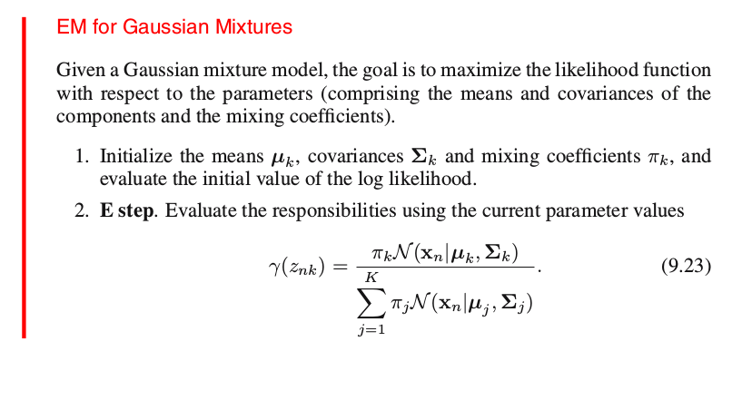
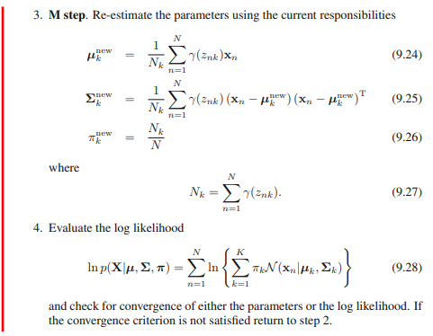
Expectation-Maximization (EM) Algorithm for GMMs
The Expectation-Maximization (EM) algorithm is an iterative method used in Gaussian Mixture Models (GMMs) to estimate the parameters (μk, Σk, πk​) of each Gaussian component. In the E-step, it computes the probabilities (responsibilities) that each data point belongs to a cluster. In the M-step, it updates the parameters to maximize the likelihood of the observed data. This process repeats until convergence, refining the model to best fit the data.

Slide 12
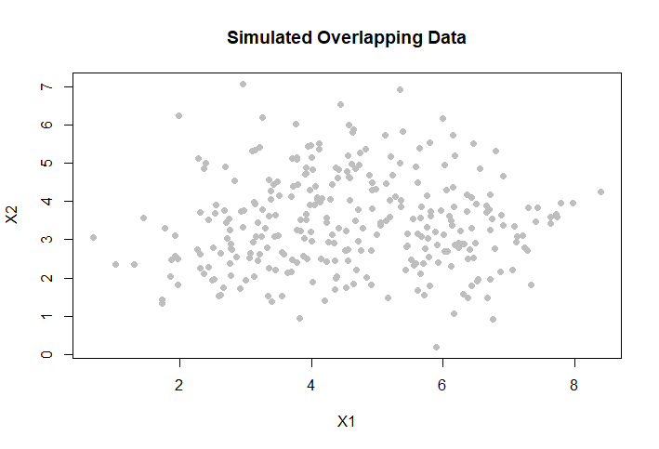
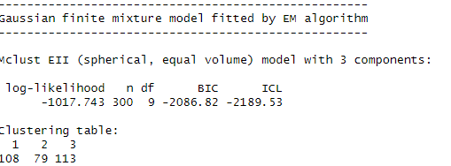
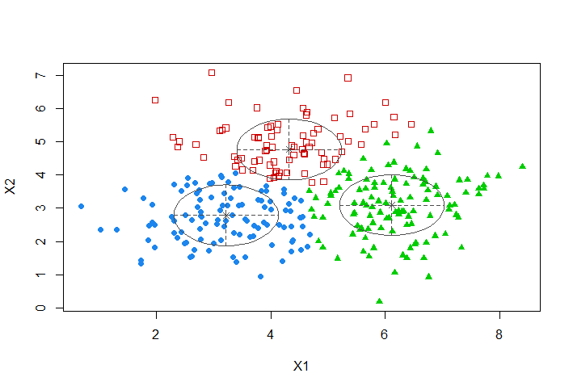
Evaluating a GMM
library(mclust)
gmm_model <- Mclust(data_overlap)
# Summary of the model
summary(gmm_model)
# Visualize clusters
plot(gmm_model, what = "classification", main = "GMM Clustering")
Log-Likelihood:
Measures how well the model explains the data. A higher log-likelihood indicates a better fit.
Can be compared across iterations to monitor convergence.
Information Criteria:
Akaike Information Criterion (AIC) and Bayesian Information Criterion (BIC) penalize model complexity to avoid overfitting.
Lower AIC or BIC values indicate a better balance between model fit and complexity.

Slide 13
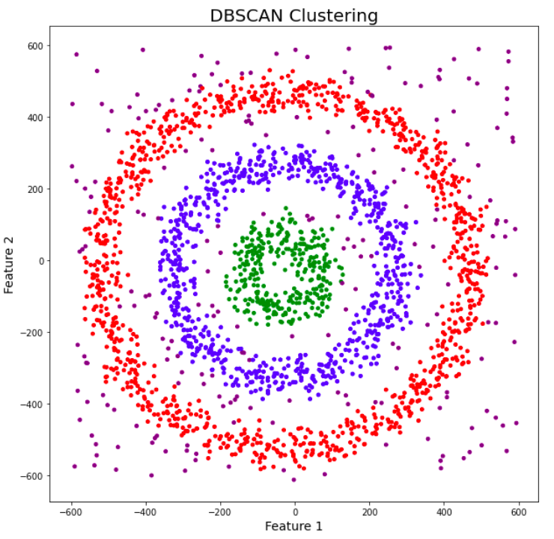
DBSCAN
AKA Density-Based Spatial Clustering of Applications with Noise
Considers clusters as areas of high density separated by areas of low density.
Does not require you to specify the number of clusters beforehand.
Efficient at marking outlier points that sit far away in low-density regions.
Useful at working with weirdly shaped distributions.

Slide 14
DBSCAN
Parameter Definitions:
ε -> Distance threshold to determine the “neighborhood” of a single point.
n -> The minimum number of points needed to form a cluster.
Algorithm:
Choose a point and determine all points within a distance ε.
If the point has at least n it is a “core point” (a new cluster is created).
Check if neighboring points are also core points.
Repeat steps 2-3 until all core points are found. Points that are within distance ε of a core point but do not have enough neighbors themselves are called border points. Finding border points ends the recursive process. process for all neighbor points, continue to expand cluster while new core points are found.
Repeat steps 1-4 until all points are classified as being part of a cluster or noise (neither a core point nor a border point).

Slide 15
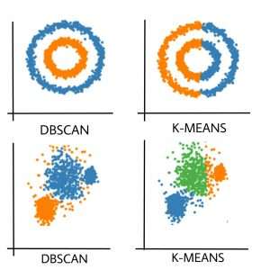
DBSCAN

Slide 16
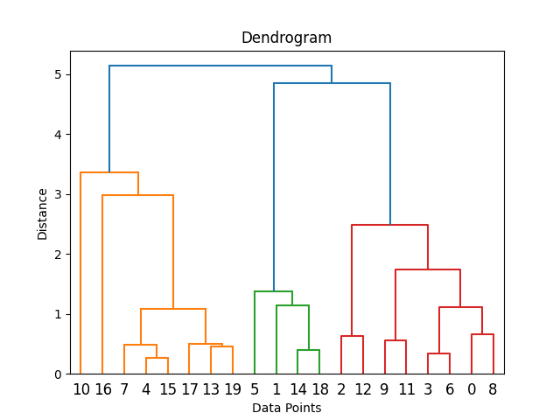
HCA
AKA Hierarchical Clustering Analysis.
Creates a hierarchical tree of objects to be clustered (a dendogram).
Does not require you to specify the number of clusters beforehand.
Very useful in providing information about data structure and patterns.
Not really useful for large datasets as it is hard to interpret.

Slide 17
HCA (Agglomerative)
Algorithm :
Agglomerative (bottom up) HCA involves first treating each individual point as its own cluster.
A distance metric is used to calculate the clusters closest to one another and join them.
Repeat step two until all points belong to a single cluster.
Distance Metrics:
Euclidean distance, manhattan distance, etc. can be used for points.
Single linkage, complete linkage, average linkage can be used for clusters.

Slide 18
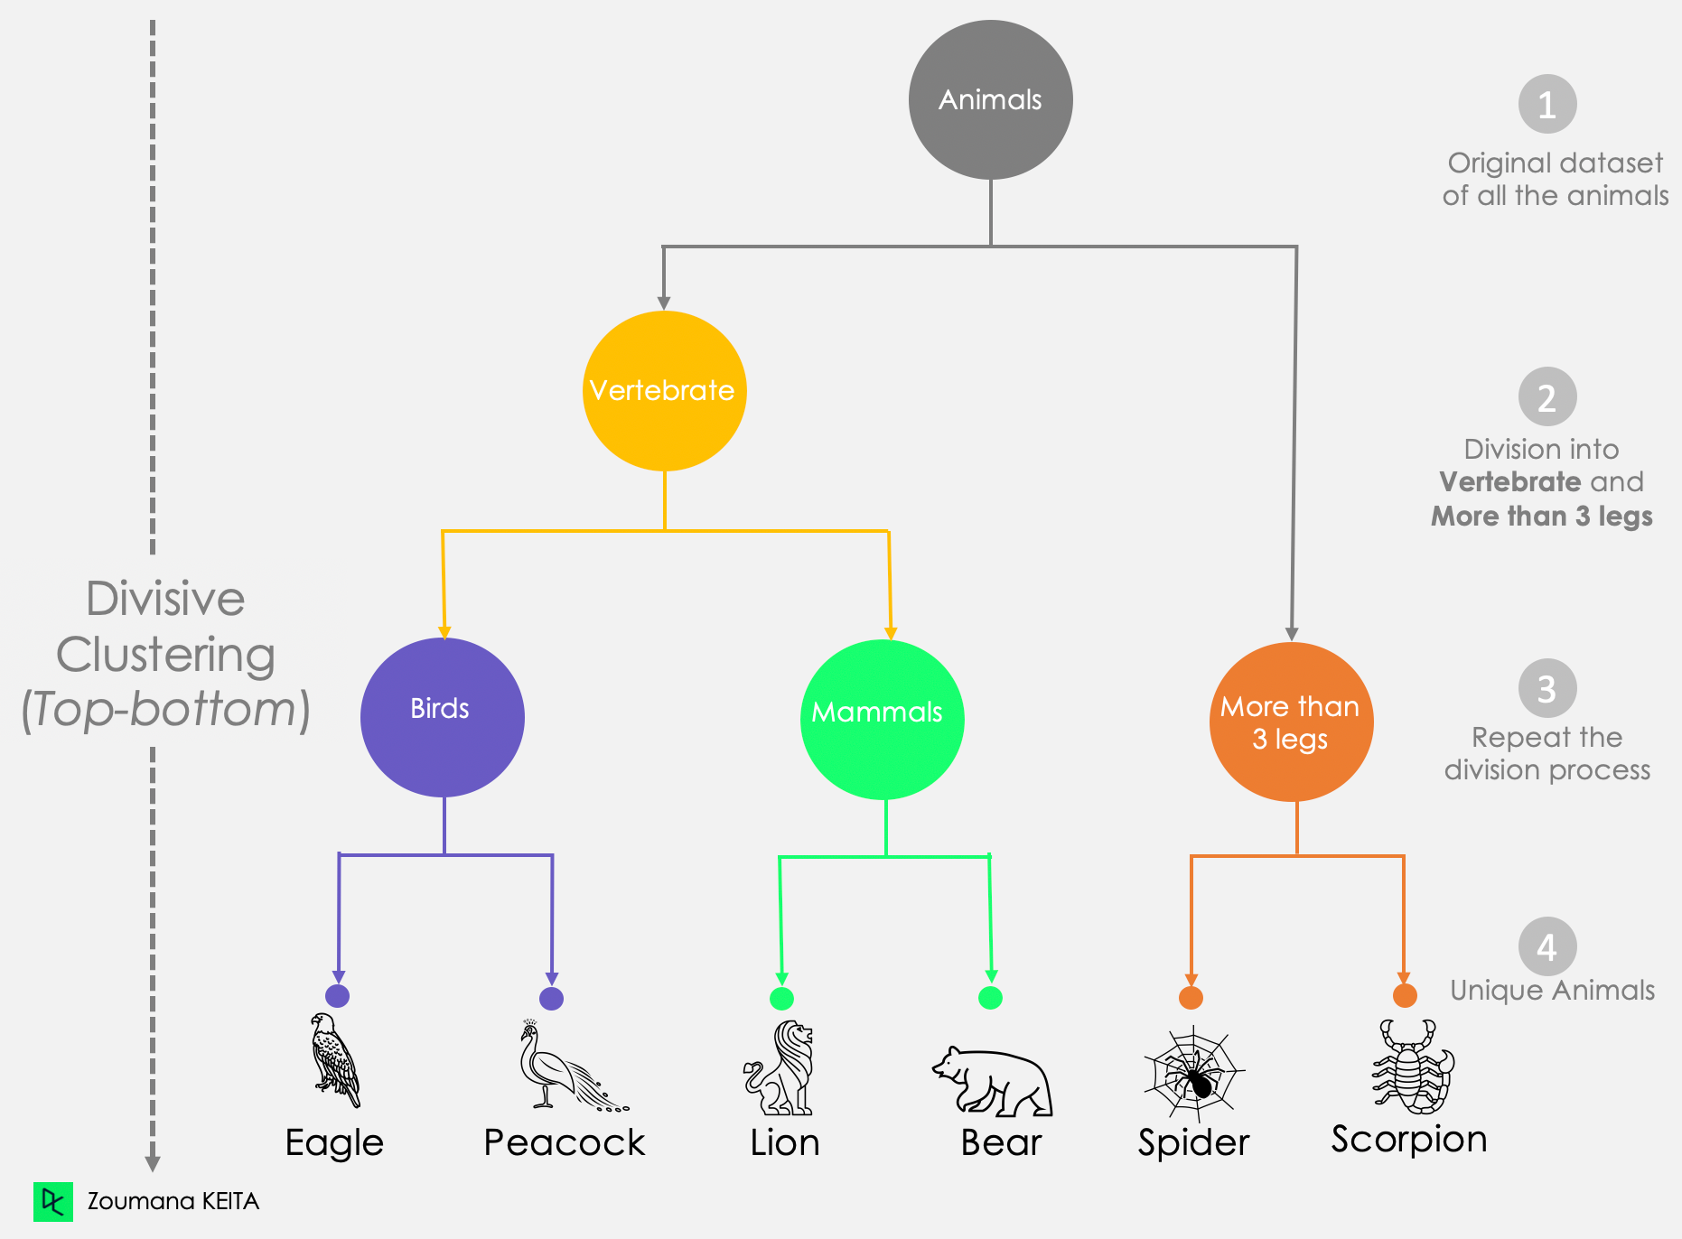
HCA (Divisive)
Algorithm :
Divisive (top down) HCA involves starts with all points as a single cluster.
A distance metric is used to determine dissimilarity between points.
Use data from Step 2 to split the cluster using another clustering method (i.e. k-means).
Repeat step two until all points are their own cluster.

Slide 19
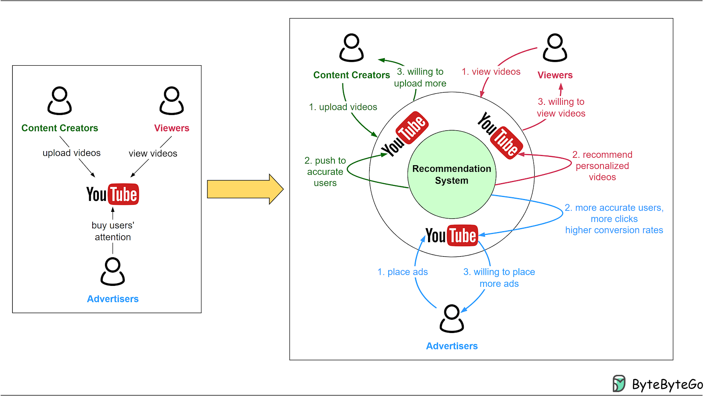
Areas of Application
1. Recommendation Engines (Example: Amazon, YouTube)
Recommendation systems like Amazon and YouTube use clustering to group users with similar preferences,
making it easier to suggest products or content.

Slide 20
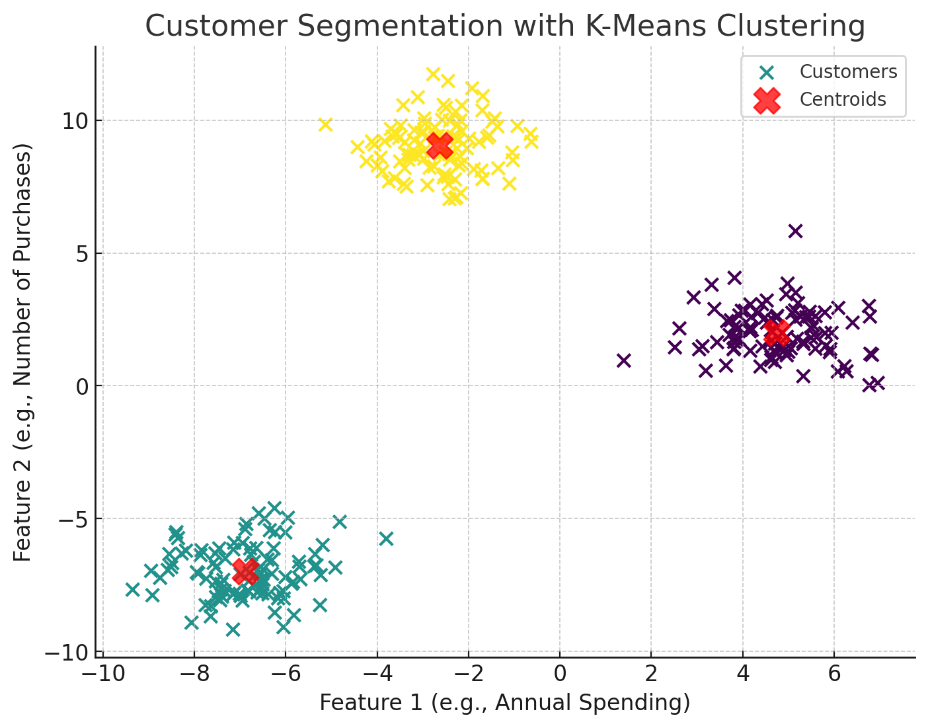
Areas of Application
2. Market and Customer Segmentation (Example: Marketing Campaigns)
Group customers based on purchasing behavior, demographics, or browsing patterns

Slide 21
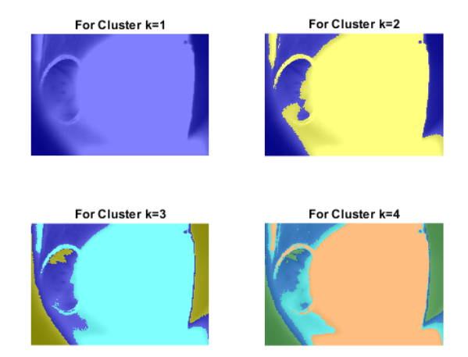
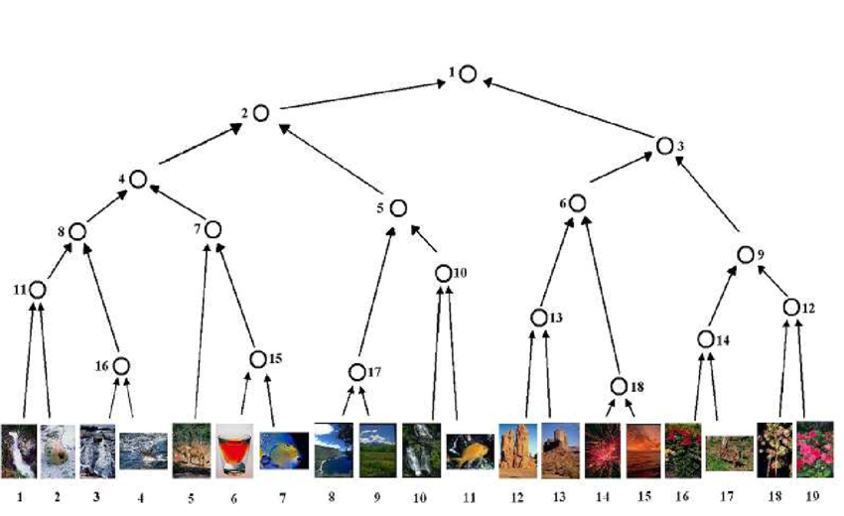
Areas of Application
3. Image Processing (Example: Object Recognition)
In image processing, clustering helps group similar features in images, which is useful in tasks like object recognition.

Slide 22
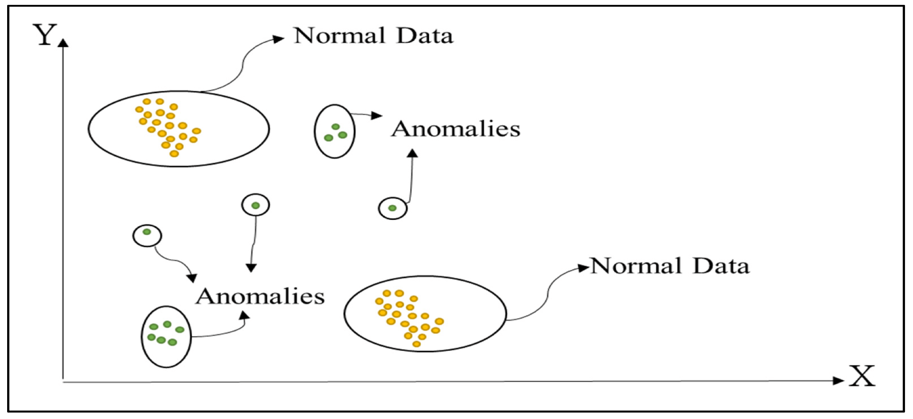
Areas of Application
4. Fraud Detection (Example: Banking Transactions)
In fraud detection, clustering helps identify unusual patterns or behaviors.
Types of Anomalies
Point Anomalies: Transactions that don't fit any cluster (e.g., an unusually large purchase) are flagged as fraud.
Contextual Anomalies: Transactions that are normal in general but out of place in context (e.g., a late-night purchase) are detected.
Collective Anomalies: A group of unusual transactions can form a separate cluster, indicating fraud.

Slide 23
Challenges in Clustering:
1. Determining the Number of Clusters: Deciding the optimal number of clusters is challenging. It often involves using techniques like the elbow method, silhouette analysis, or gap statistics, but these methods may yield conflicting results depending on the dataset.
2. Sensitivity to Noise and Outliers: Clustering algorithms can be highly sensitive to noise, leading to distorted clusters or misclassification. For instance, K-means is particularly vulnerable to outliers because it minimizes variance, which can be skewed by extreme values.
3. Choosing the Right Clustering Method: No single clustering method works universally. Methods like K-means are effective for spherical clusters, but others like DBSCAN are better for arbitrary shapes. Choosing an unsuitable method can lead to inaccurate clustering.
4. Interpreting Nonlinear Models: Algorithms like spectral clustering or deep learning-based clustering produce complex, nonlinear models that are harder to interpret compared to simpler methods like K-means.
5. Computational Complexity: Clustering large datasets can be computationally intensive, especially with algorithms like hierarchical clustering or Gaussian Mixture Models, which may not scale well.

Slide 24
Considerations for Clustering:
1. Data Preprocessing: Proper data preprocessing is essential for quality results. This includes:
• Handling missing values.
• Normalizing or scaling features to ensure equal contribution.
• Addressing imbalanced data distributions if they exist.
2. Model Validation:
• Ensuring the model generalizes well to new data involves techniques like: Cross-validation.
• Evaluating cluster stability by bootstrapping or repeated sampling.
3. Model Interpretability: The clusters must make sense in the real-world context of the problem. Highly complex models might give technically accurate clusters but are difficult to explain or apply practically.
4. Scalability: With large datasets, consider algorithms optimized for scalability, such as MiniBatch K-means or distributed implementations of clustering methods.
5. Avoiding Overfitting: Overfitting in clustering can occur when the model fits the noise or outliers in the data. Regular validation and noise reduction techniques can help mitigate this risk, By keeping these challenges and considerations in mind, clustering can be applied more effectively in real-world scenarios.

Slide 25
Results and Conclusion
Effectiveness of Clustering in Predictive Analytics
Unsupervised learning allows for discovering hidden patterns without labeled data.
Clustering is effective for segmenting data into meaningful groups, such as customer segmentation, anomaly detection, or market trend analysis.
It helps generate insights that drive decisions in marketing, business strategies, and product development.
Results from clustering models can enhance predictive models by revealing patterns and relationships that were not initially obvious.
Final Thoughts
Clustering remains a crucial tool in analytics, offering value in exploratory data analysis and when labels are not available.
As data becomes more complex, clustering will continue to evolve with advancements in algorithms and integration with other AI techniques like deep learning.
Future Developments: Continued improvement in clustering techniques could enable even more accurate groupings in larger, more complex datasets, enhancing decision-making in real-time applications.
Notes:
# 8 Puja
In summary clustering is very effective in predictive analytics. As an unsupervised learning technique we can segment data into meaningful groups without labeled data, so it’s very useful for customer segmentation, anomaly detection and market trend analysis. By revealing hidden patterns clustering helps generate insights that inform business decisions, marketing strategies and product development.
Looking forward clustering will continue to be a key tool in analytics. As the volume and complexity of data grows we will see clustering techniques evolve with advancements in algorithms especially when combined with other AI technologies like deep learning. In the future more advanced clustering models will lead to even more accurate groupings and real time decision making across many industries.

Slide 26
References
Bishop, C. M. (2006). Pattern Recognition and Machine Learning. Springer.
Kuhn, M., & Johnson, K. (2013). Applied Predictive Modeling. Springer.
Tan, P.-N., Steinbach, M., & Kumar, V. (2005). Introduction to Data Mining. Pearson.
R Documentation: mclust Package: URL: https://cran.r-project.org/web/packages/mclust/index.html
Eric J, Why Do We Use Clustering? 5 Benefits and Challenges In Cluster Analysis https://datarundown.com/why-clustering/
geeksforgeeks, DBSCAN Clustering in ML | Density based clustering https://www.geeksforgeeks.org/dbscan-clustering-in-ml-density-based-clustering/

